Slide 1
STREAMS

Slide 2
Streams:
Collection of data
Sequence of characters or numbers or objects
Way to handle any kind of end-to-end information exchange in efficient way

Slide 3

Are streams unique to node.js?

Slide 4
Introduced in UNIX operating system many decades ago
Programs can interact with each other using pipe operator (|)
Simply, output of one process can be given to another process
Let’s see example

Slide 5
Advantages of streams:
Memory efficiency
Time efficiency
Back pressure
Simplify the processing

Slide 6
Memory efficiency:
Converts large amount of data in chunk of data
So no need to load large amount of data in memory before starting the process

Slide 7
Time efficiency:
Won’t wait for whole data payload
Starts processing for available chunk of data

Slide 8
Back pressure:
If one process takes more time to complete, the flow of data can be slowed down from the root which was handled by node.js itself

Slide 9
Use case:
Read data -> Process data -> Write data
Writing to a disk is a lot slower than reading from a disk
It didn’t push all chunk of data in write queue
It slows down the read stream process

Slide 10
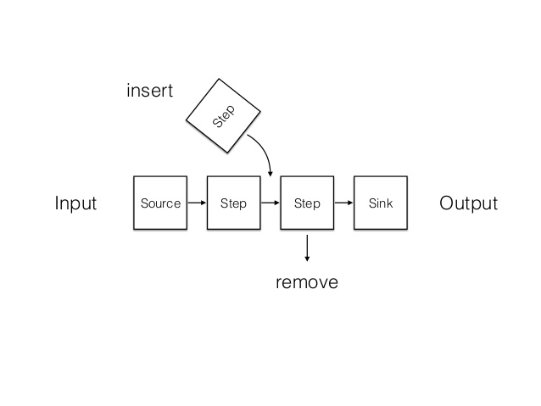
Simplify the processing
It is simple to add, delete or modify the stream processing step

Slide 11

How to connect two process in streams?
Step-1
Step-2

Slide 12
pipe():
pipe() takes the source and pipes it into destination process
Return value of the pipe() method is the destination stream
We can chain multiple pipes
inputStream.pipe(modifyStream1).pipe(modifyStream2).pipe(desiredOutput)

Slide 13
Can we directly modify the stream data?

Slide 14


Slide 15
How to process stream data?
We can process data using stream.Transform subclass
It has method called transform which can able to read chunks and pushing the transformed data

Slide 16
How to process stream data?
We can process data using stream.Transform subclass
It has method called transform which can able to read chunks and pushing the transformed data

Slide 17
How to process stream data?
Three arguments of transform method:
Chunk -> Output of previous step
Encoding -> Encoding type
Callback
After modifying/ manipulating data, return it using callback(error, modifiedData)
If no error occured, then use callback(null, modifiedData)

Slide 18

Don’t keep calm, it’s demo time.

